Slide 1
Web Application Development ISCG7420 Introduction to Web Development
School of Computing, Electrical and Applied Technology

Slide 2
Outlines
Software Architecture
Software Architectural Patterns
Database Technology
Database Management Systems Review

Slide 3
Software Architecture
Software architecture refers to the fundamental structures of a software system and the discipline of creating such structures and systems. Each structure comprises software elements, relations among them, and properties of both elements and relations.

Slide 4
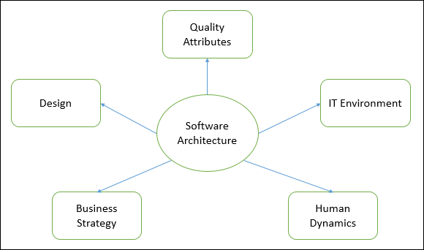
Software Architecture

Slide 5
Software Architecture
Architecture serves as a blueprint for a system. It provides an abstraction to manage the system complexity and establish a communication and coordination mechanism among components.

Slide 6
Software Architecture – Decisions to make
Selection of structural elements and their interfaces by which the system is composed.
Behavior as specified in collaborations among those elements.
Composition of these structural and behavioral elements into large subsystem.
Architectural decisions align with business objectives.
Architectural styles guide the organization.

Slide 7
Goals of Software Architecture
Identifies requirements that affect the structure of the application.
Reduces the business risks associated with building a technical solution and builds a bridge between business and technical requirements.

Slide 8
Other Goals of Software Architecture
Expose the structure of the system, but hide its implementation details.
Realize all the use-cases and scenarios.
Try to address the requirements of various stakeholders.
Handle both functional and quality requirements.
Reduce the goal of ownership and improve the organization’s market position.
Improve quality and functionality offered by the system.
Improve external confidence in either the organization or system.

Slide 9
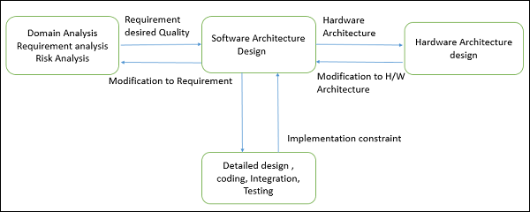
Software Design
Software design provides a design plan that describes the elements of a system, how they fit, and work together to fulfill the requirement of the system.

Slide 10
Software Design
To negotiate system requirements, and to set expectations with customers, marketing, and management personnel.
Act as a blueprint during the development process.
Guide the implementation tasks, including detailed design, coding, integration, and testing.

Slide 11
Software Architectural Patterns
An architectural pattern is a general, reusable solution to a commonly occurring problem in software architecture within a given context. Architectural patterns are similar to software design pattern but have a broader scope.

Slide 12
10 common architectural patterns
Layered pattern
Client-server pattern
Master-slave pattern
Pipe-filter pattern
Broker pattern
Peer-to-peer pattern
Event-bus pattern
Model-view-controller pattern
Blackboard pattern
Interpreter pattern

Slide 13
Layered pattern
Layered pattern can be used to structure programs that can be decomposed into groups of subtasks, each of which is at a particular level of abstraction. Each layer provides services to the next higher layer.
The most commonly found 4 layers of a general information system are as follows.
Presentation layer (also known as UI layer)
Application layer (also known as service layer)
Business logic layer (also known as domain layer)
Data access layer (also known as persistence layer)

Slide 14
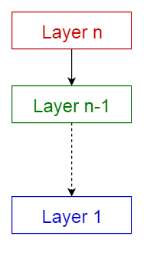
Layered pattern - usage
General desktop applications.
E commerce web applications.

Slide 15
Client-server pattern
Consists of two parties; a server and multiple clients. The server component will provide services to multiple client components. Clients request services from the server and the server provides relevant services to those clients. Furthermore, the server continues to listen to client requests.

Slide 16
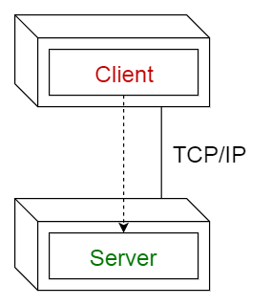
Client-server pattern - usage
Online applications such as email, document sharing and banking.

Slide 17
Master-slave pattern
Consists of two parties; master and slaves. The master component distributes the work among identical slave components, and computes a final result from the results which the slaves return.

Slide 18
Master-slave pattern - usage
In database replication, the master database is regarded as the authoritative source, and the slave databases are synchronized to it.
Peripherals connected to a bus in a computer system (master and slave drives).

Slide 19
Pipe-filter pattern
Is used to structure systems which produce and process a stream of data. Each processing step is enclosed within a filter component. Data to be processed is passed through pipes. These pipes can be used for buffering or for synchronization purposes.

Slide 20
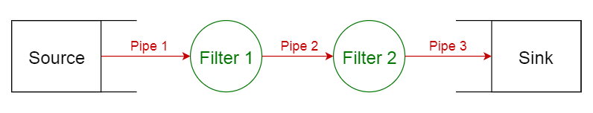
Pipe-filter pattern - usage
Compilers. The consecutive filters perform lexical analysis, parsing, semantic analysis, and code generation.
Workflows in bioinformatics.

Slide 21
Broker pattern
is used to structure distributed systems with decoupled components. These components can interact with each other by remote service invocations. A broker component is responsible for the coordination of communication among components.

Slide 22
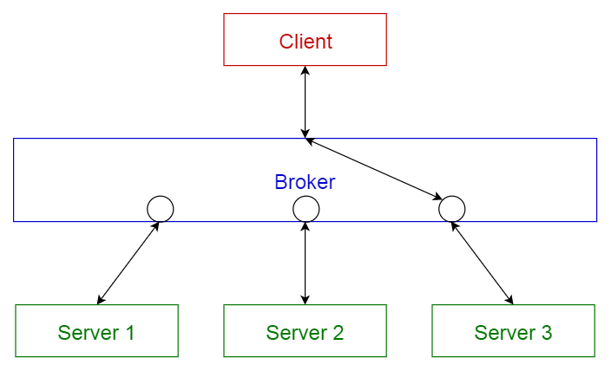
Broker pattern - usage
Message broker software such as Apache ActiveMQ, Apache Kafka, RabbitMQ and JBoss Messaging.

Slide 23
Peer-to-peer pattern
Peers may function both as a client, requesting services from other peers, and as a server, providing services to other peers. A peer may act as a client or as a server or as both, and it can change its role dynamically with time.

Slide 24
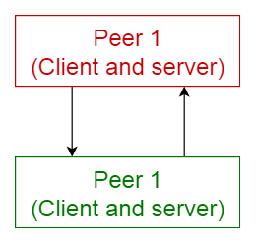
Peer-to-peer pattern - usage
File-sharing networks such as Gnutella and G2
Multimedia protocols such as P2PTV and PDTP.
Cryptocurrency-based products such as Bitcoin and Blockchain

Slide 25
Event-bus pattern
This pattern primarily deals with events and has 4 major components; event source, event listener, channel and event bus. Sources publish messages to particular channels on an event bus. Listeners subscribe to particular channels. Listeners are notified of messages that are published to a channel to which they have subscribed before.

Slide 26
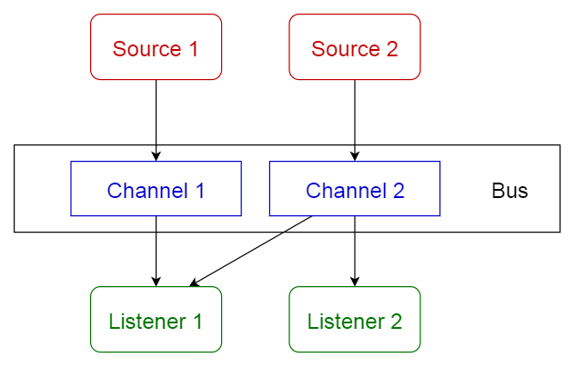
Event-bus pattern - usage
Android development
Notification services

Slide 27
Model-view-controller pattern
Model — contains the core functionality and data
View — displays the information to the user (more than one view may be defined)
Controller — handles the input from the user

Slide 28
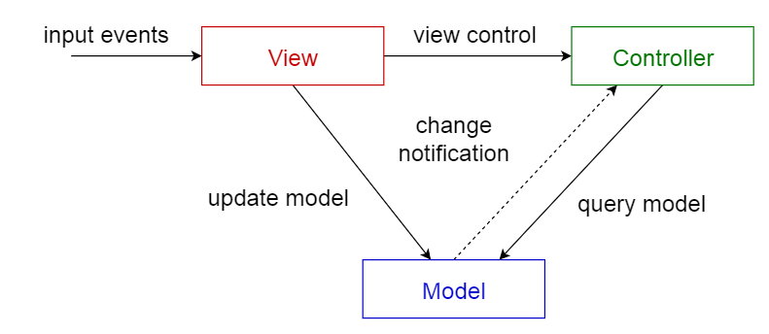
Model-view-controller pattern - usage
Architecture for World Wide Web applications in major programming languages.
Web frameworks such as Django and Rails.

Slide 29
Blackboard pattern
is useful for problems for which no deterministic solution strategies are known.
Blackboard — a structured global memory containing objects from the solution space
Knowledge source — specialized modules with their own representation
Control component — selects, configures and executes modules.

Slide 30
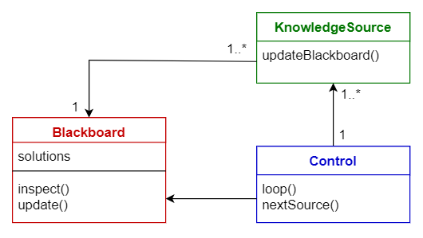
Blackboard pattern - usage
Speech recognition
Vehicle identification and tracking
Protein structure identification
Sonar signals interpretation.

Slide 31
Interpreter pattern
This pattern is used for designing a component that interprets programs written in a dedicated language. It mainly specifies how to evaluate lines of programs, known as sentences or expressions written in a particular language. The basic idea is to have a class for each symbol of the language.

Slide 32
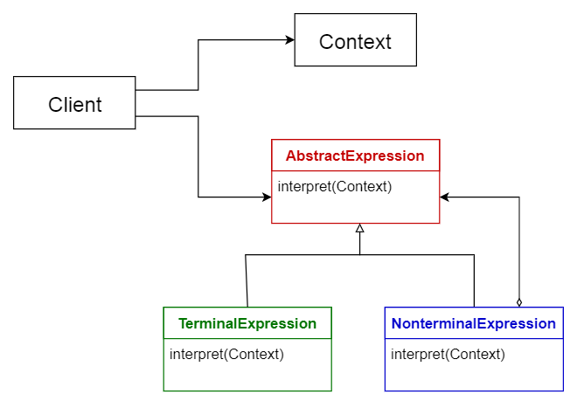
Interpreter pattern - usage
Database query languages such as SQL.
Languages used to describe communication protocols.

Slide 33
Database technology
Database is an organized collection of data stored and accessed electronically from a computer system.
The database management system (DBMS) is the software that interacts with end users, applications, and the database itself to capture and analyze the data.

Slide 34
DBMS
Data definition – Creation, modification and removal of definitions that define the organization of the data.
Update – Insertion, modification, and deletion of the actual data.
Retrieval – Providing information in a form directly usable or for further processing by other applications. The retrieved data may be made available in a form basically the same as it is stored in the database or in a new form obtained by altering or combining existing data from the database.
Administration – Registering and monitoring users, enforcing data security, monitoring performance, maintaining data integrity, dealing with concurrency control, and recovering information that has been corrupted by some event such as an unexpected system failure.

Slide 35
Types of database
Relational databases
Microsoft SQL Server, Oracle Database, MySQL, PostgreSQL and IBM Db2
NoSQL databases
Apache Cassandra, MongoDB, CouchDB, and CouchBase
Cloud databases
Microsoft Azure SQL Database, Amazon Relational Database Service, Oracle Autonomous Database.
Columnar databases
Google BigQuery, Cassandra, HBase, MariaDB, Azure SQL Data Warehouse
Wide column databases
BigTable, Apache Cassandra and Scylla

Slide 36
Types of database – cont.
Object-oriented databases
Wakanda, ObjectStore
Key-value databases
Amazon DynamoDB, Redis
Hierarchical databases
IBM Information Management System (IMS), Windows Registry
Document databases
MongoDB, Amazon DocumentDB, Apache CouchDB
Graph databases
Datastax Enterprise Graph, Neo4J
Time series databases
Druid, eXtremeDB, InfluxDB

Slide 37
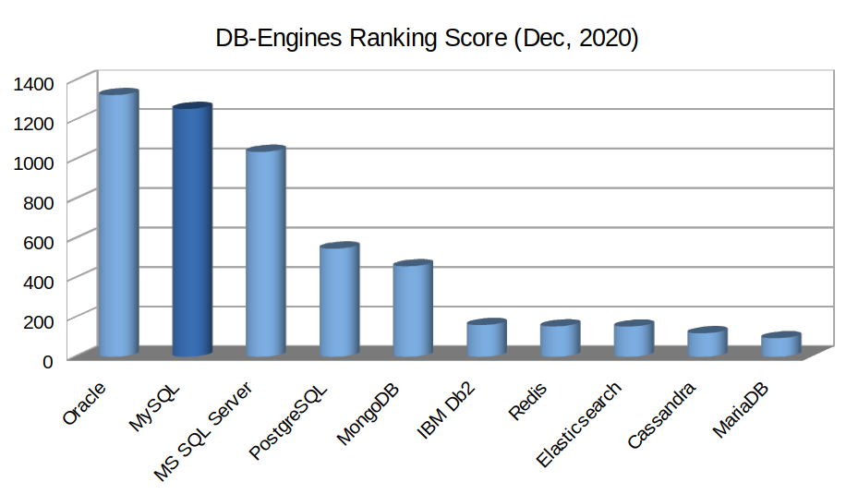
10 Popular Databases
MySQL
Oracle
PostgreSQL
Microsoft SQL Server
MongoDB
Redis
Elasticsearch
Cassandra
MariaDB
IBM Db2

Slide 38
MySQL
Open Source Relational Database Management System
Focuses on robustness, stability, and maturity.

Slide 39
MySQL – Key Features
Open source RDBMS with two licensing models: free Community Server and proprietary Enterprise Server.
Offers ACID (atomicity, consistency, isolation, durability) transactional guarantee (with InnoDB engine). In terms of CAP (Consistency, Availability, Partition tolerance), it offers immediate Consistency.
Offers horizontal partitioning (sharding) via its Shared Nothing MySQL Cluster. As a result, it offers high availability and high throughput with low latency and near-linear Scaling.
With its MySQL Cluster, it offers multi-master ACID transactions.
Multi-model database and supports both structured data (SQL) and semi-structured data (JSON).

Slide 40
When to Use MySQL
Structured Data (SQL) with an ACID transaction guarantee.
Horizontal Scalability is a key requirement, especially with Write heavy data.
Multi-Master ACID transaction is a fundamental requirement.
Data Security is a key feature.
A Converged database is required, i.e., one database for both OLTP(Online transaction processing) and OLAP(Online analytical processing) workload.

Slide 41
When not to Use MySQL
“Distributed SQL” is required where millions of transactions should be handled in a globally distributed database.
Data is extremely relational (e.g., Social Media), i.e., Graph like data.
Data is Semi-structured, i.e., JSON data with advanced query features.
Advanced-data Protection (e.g., Masking, Obfuscating, Throttling) is a must.

Slide 42
Oracle
Relational Database Management System

Slide 43
Oracle - Key Features
Proprietary RDBMS.
Offers ACID transactional guarantee. In terms of CAP, it offers immediate Consistency as a single Server.
Advanced Multi-Model databases supporting Structured Data (SQL), Semi-Structured Data(JSON, XML), Spatial Data, and RDF Store. Offers multiple access pattern depending on the specific Data Model
Offers Blockchain Tables.
Supports both OLTP and OLAP workload.

Slide 44
When to Use Oracle
If a company wants to have a Converged database or Master Database (One database for OLTP and OLAP).
Traditional transactional workloads with structured (SQL) data, and when ACID transaction guarantee is a key criterion.
Blockchain Table is required.
For Data Warehousing.
A multi-model database including Geospatial Data type is an essential requirement.

Slide 45
When not to Use Oracle
If a company wants to save money on a database.
Multi-Master ACID transaction is a must-have feature.
Data is Semi-structured, i.e., JSON data with advanced query functions.
Data is extremely relational (e.g., Social Media), i.e., Graph like data.

Slide 46
PostgreSQL
The most Advanced Open Source Relational Database

Slide 47
PostgreSQL – Key Features
Open Source RDMBS with a very permissible PostgreSQL license. There are many extensions of PostgreSQL with various advanced features.
Offers ACID transactional guarantee. In terms of CAP, it offers immediate Consistency as a single Server.
Citus Data, a PostgreSQL extension, offers much-coveted Distributed SQL features, i.e., a database with the transactional guarantee of an SQL database and horizontal scaling of NoSQL database.
It offers more Advanced indexes liked partial Index, Bloom Filters. Also, creating an Index in PostgreSQL is non-blocking.
It is a feature-rich multi-model database supporting Structured Data (SQL), Semi-Structured Data (JSON, XML), Key-Value, Spatial Data.

Slide 48
When to Use PostgreSQL
Data is structured (SQL), and ACID transaction guarantee is a key criterion with strict Data integrity.
When “Distributed SQL” is required, where millions of transactions should be handled in a globally distributed database.
A sophisticated query planner is wanted.
Advanced Reliability and Disaster Recovery is desired, e.g., PITR, Active Standbys.
A multi-model database including Geospatial Data type is expected.

Slide 49
When not to Use PostgreSQL
Multi-Master ACID transaction is a must-have feature.
Data is Semi-structured, i.e., JSON data with advanced query planers.
A Converged database (OLTP and OLAP) is required.
Data is extremely relational (e.g., Social Media), i.e., Graph like data.

Slide 50
Microsoft SQL Server
The leading commercial database Systems with excellent Tooling support from Microsoft.

Slide 51
Microsoft SQL Server - Key Features
Proprietary RDBMS with diverse licenses: Developer and Express (free), Standard, and Enterprise (commercial).
Offers ACID transactional guarantee. In terms of CAP, it offers immediate Consistency as a single Server.
Supports Server-side scripting via T-SQL, .NET languages, R, Python, and Java.
It is a multi-Model database supporting Structured Data (SQL), Semi-Structured Data(JSON), Spatial Data.
Excellent Tooling Support for both On-premise and Cloud. Also, Azure offers tooling to move On-premise SQL Server to Cloud with ease.

Slide 52
When to Use SQL Server
Data is structured (SQL) with an ACID transaction guarantee.
The development platform is strongly coupled with other Microsoft Products.
Azure Cloud is the preferred public Cloud Technology with a preference for Managed SQL database.
A company already has MS-SQL databases and wants to lift-and-shift them in Cloud.

Slide 53
When not to Use SQL Server
Not ideal for companies with low Budgets for databases.
Multi-Master ACID transaction is a must-have feature.
Data is Semi-structured, i.e., JSON data, and needs advanced query operations.
Distributed SQL database is desired.
A Converged database is needed.

Slide 54
MongoDB
Supports Semi-Structured data
Supports application-level mapping
Handles the Document Data

Slide 55
MongoDB – Key Features
Open-Core NoSQL Document Database (BSON) with various licenses: Community Server (free), Enterprise Server (commercial), Atlas (managed in Cloud).
Offers horizontal scaling via Auto-Sharding and has built-in replication via primary-secondary nodes. In terms of CAP, it is CP (Consistent and Partition tolerant).
Distributed multi-document ACID transactions with snapshot isolation.
Rich and powerful query language with complex querying using aggregation pipeline. It also supports Map-Reduce query, text search, graph search, and geo-search.
MongoDB Inc. also offers a full-text search engine (Atlas Search) and data lake (Atlas Data Lake) built on MongoDB.

Slide 56
When to Use MongoDB
Data is Document or semi-structured(e.g. JSON, XML) with advanced query features.
Fast application development where the schema is continuously changing.
Large structured data is normalized to multiple SQL tables and suffers in terms of performance and complexity.
Data is Schema-less.
Consistency is preferred over availability for semi-structured data.

Slide 57
When not to Use MongoDB
Data is structured data.
Data is extremely relational (e.g., Social Media), i.e., Graph like data.
For Data Warehousing (OLAP database).
Multi-Master write is needed for write-heavy loads.
High availability is preferred over Consistency.

Slide 58
Redis
Distributed in-memory key-value store
Highly-scalable in-memory data structure store used extensively in the industry

Slide 59
Redis - Key Features
Open Core distributed in-memory NoSQL data structure store with BSD 3-clause license.
Used as a distributed, in-memory key-value database. Also used as a distributed cache (with or without database) or as message broker with optional durability.
Supports a wide range of data structures: strings, hashes, lists, sets, sorted sets with range queries, bitmaps, hyper-logs, geospatial indexes, and streams.
Highly scalable with built-in replication, automatic failover, and sharding via Redis Cluster. In terms of CAP, it is CP (Consistent and Partition tolerant).
Advanced Cache functionality (LRU eviction policy, Keys with limited TTL).

Slide 60
When to Use Redis
The distributed in-memory data structure is required.
Distributed and enterprise-grade caching is required, e.g., to improve database access performance.
For Session Management.
Real-time use cases, e.g., Inventory systems.
For a large amount of Dataset.

Slide 61
When not to Use Redis
Single server in-memory data structure store is required for a small set of data.
Primary data storage (OLTP Database) with an ACID transactional guarantee.
Single Server caching is needed for a small set of data.
Data is extremely relational (e.g., Social Media), i.e., Graph like data.
When an OLAP database is needed.

Slide 62
Elasticsearch
For full-text search
Distributed, multi-tenant capable full-text search engine offering REST API

Slide 63
Elasticsearch – Key Features
Open Core, distributed search engine.
Offers horizontal scaling via automatic sharding. It is the most scalable search engine. In terms of CAP, it is AP (Available and Partition Tolerant).
Offer REST API and supports structured and schemaless data (JSON). As a result, it is especially suited to analyze Logging or Monitoring data.
Support automatic replication and Cross-cluster Replication (CCR).
Part of the formidable “Elastic Stack” (Elasticsearch, Kibana, Logstash, Beats). Organizations use it massively in the Observability landscape.

Slide 64
When to Use Elasticsearch
Moderate to advanced full-text search is needed.
Near real-time full-text search is required with advanced machine learning features (e.g., fraud detection).
Search engine with advanced tooling support (Kibana, Logstash, Beats).
For a large volume of data sets.
Semi-structured data (e.g., JSON, Log Data) is used.

Slide 65
When not to Use Elasticsearch
Only basic full-text search features are required.
ACID-compliant primary database (OLTP Database) is required.
Dataset is small and only structured data.
Only full-text search is required without sophisticated tooling (Kibana, Logstash).
When cutting-edge but expensive features like advanced machine learning is not a key requirement.

Slide 66
Cassandra
Facebook’s massive scaling problem
Highly scalable database and widely used in the industry to handle massive data.

Slide 67
Cassandra – Key Features
Open Core, distributed, Wide Column Store database with Apache License 2.0.
Used as OLAP Database (e.g., Data Warehouse) to handle the gigantic volume of data. Also used as a time-series database.
Offers linear horizontal scaling and one of the most scalable databases with automatic sharding. In terms of CAP, it is AP (Available and Partition Tolerant).
Decentralized database (Leaderless) with automatic replication and multi-datacenter replication. As a result, it is fault-tolerant with no single point of failure.
Has user-friendly and SQL like query language: Cassandra Query Language (CQL).

Slide 68
When to Use Cassandra
As typical OLAP database, e.g., as Data Warehouse.
As a time series database with massive write operations.
Web-Scale applications need to handle a massive amount of write and read operations with linear scalability.
For high durable use cases when data-loss is acceptable.

Slide 69
When not to Use Cassandra
As a primary database (OLTP) needing an ACID transaction guarantee.
If linear scalability is not required or high-availability is not required.
If Data is frequently deleted, then its performance degrades (“Tombstones”).
It is JVM based and needs more Node, and causes a hefty Cloud bill. The C++ based Cassandra compliant ScyllaDB is a better option to save Cloud bill.

Slide 70
MariaDB
Relational Database Management System and compatible with MySQL protocol and MySQL clients.

Slide 71
MariaDB – Key Features
Open source RDBMS with GPL v2 license. It has two licensing models: free Community Server and commercial Enterprise Server.
Offers ACID transactional guarantee (with InnoDB engine). In terms of CAP, it offers immediate Consistency as a single Server.
With its Storage Engine “ColumnStore,” MariaDB offers columnar storage with massively parallel distributed data architecture. It also offers horizontal partitioning (sharding) via its MaxScale and Spider Engine. Thus MariaDB is also suitable as an OLAP database.
With its Graph Computation Engine “OQGRAPH,” it supports hierarchical and complex graph data types.
With its Xpand smart Storage, it offers the “Distributed SQL” features out-of-the-box. As a result, it offers Millions of transactions per second.

Slide 72
When to Use MariaDB
Data is structured (SQL), and ACID transaction guarantee is a key criterion.
“Distributed SQL” is required where millions of transactions should be handled in a globally distributed database.
Multi-Master clustering and Multi-Node data warehousing are required (OLAP).
A multi-model database is required, i.e., one database to handle structured, semi-structured, graph, and columnar data.
A converged database is required, i.e., one database for OLTP, OLAP, and Graph workload.

Slide 73
When not to Use MariaDB
Multi-Master ACID transaction is a must-have feature.
Data is Semi-structured, i.e., JSON data and highly advanced query functions are needed.
Advanced Indexing like descending, functional and invisible are expected.
Advanced Authentication and Authorization (e.g., Password reuse policies, partial revokes) are desired.

Slide 74
IBM Db2
Commercially supported RDBMS

Slide 75
DB2 – Key Features
Db2 is a proprietory RDBMS with an ACID transactional guarantee. It has different licenses: Community (free), Standard, and Advanced (commercial).
One of the most advanced Multi-Model databases supporting structured data (SQL), semi-structured data (JSON), and Graph Data.
It is also a Converged database (or Master database) and has excellent OLAP support via IBM BLU Acceleration (In-memory computing, Massively Parallel Computing, Column-based Db2 Shadow tables).
Native support for AI.
Offer horizontal scaling via Db2 pureScale.

Slide 76
When to Use Db2
If Converged database or Master Database (One database for all-purpose) is a key requirement.
As a primary Database (OLTP Database) with an ACID transaction guarantee.
AI functionality in the database is required for competitive advantage.
As OLAP database (e.g., Data Warehouse).
The company is already using IBM Cloud or IBM Cloud Pack for Data.

Slide 77
When not to Use Db2
If the company wants to save money or on budget.
Multi-Master ACID transaction is a must-have feature.
Data is Semi-structured, i.e., JSON data with advanced query functions.
A pure SQL database is required without AI functionality.
When only Azure or Google Cloud is used as Cloud provider.

Slide 78
Summary
DBSM | Relational | Commercial databases
MySQL | Yes
PostgreSQL | Yes
MS SQL | Yes
MariaDB | Yes
Oracle |  | Yes
IBM Db2 |  | Yes
NoSQL |  | Yes
MongoDB |  | Yes
Redis |  | Yes
Elasticsearch |  | Yes
Cassandra

Slide 79
Resources
https://www.tutorialspoint.com/software_architecture_design/introduction.htm
https://towardsdatascience.com/10-common-software-architectural-patterns-in-a-nutshell-a0b47a1e9013
https://en.wikipedia.org/wiki/Database
https://www.matillion.com/resources/blog/the-types-of-databases-with-examples
https://towardsdatascience.com/top-10-databases-to-use-in-2021-d7e6a85402ba

